Slide 1




ELECTRICAL
WORK PLAN
04/09/21
Amrita Mayavaram
 | EDS Design | Power Supply | Microcontroller
4/2 - 4/8 | Design & order test boards | Implement CDR feedback Design PCB | Get familiar with arduino
4/9 - 4/15 | Contact companies for custom connectors Revise large PCB design Create test plan | Bootstrap circuitry Order PCB | Program phases
4/16 - 4/22 | Soldering/Help with tests Continue design work | Space grade components | Help with tests Operational mode programming
4/23 - 4/29 | Design and order PCB for single panel prototype | Modify design and order new PCB if needed | Operational mode programming
4/30 - 5/6 | Contact rigid flex PCB manufacturers | Space grade components | Operational mode programming
5/7 - 5/13 | Soldering/Help with tests | Modify design based on tests | Soldering/ Help with tests
5/14 - 5/20 | Writing | Writing | Writing
5/21 - 5/27 | Revise designs based on test results Order rigid flex PCB | Modify design and order PCB | Look into more advanced controls
5/28 - 6/3 | Finalize and order additional components | Finalize and order additional components | Controls design
IMPORTANT TARGET DATES
4/24 – Informal Design Review
4/30 – Order Deadline for Mid-Project Report Prototype
5/10 – Complete Assembly of Electronics for MPR Prototype
5/30 – Order Deadline for End-of-Term Prototype

Slide 2
ELECTRICAL
BUDGET
04/09/21
Amrita Mayavaram
EDS Design |  | Power Supply |  | Microcontroller
Item | Price | Item | Price | Item | Price
Test Boards | $250 | Earth Prototype Components | $1,000 | Arduino | $25
HV Wire | $30 | Test PCB | $100 | Breadboard | $10
Rigid PCBs | $400 | 2nd Test PCB + Components | $1,100
Rigid Flex PCBs | $1,000 | Breadboard (wood) | $20
Connectors | $1,000 | Space Grade Components | $5,000
Acrylic Conformal Coating | $25 | Space Grade PCB | $300
Subtotal | $2,705 |  | $7,520 |  | $35
 |  |  |  | TOTAL | $10,260

Slide 3
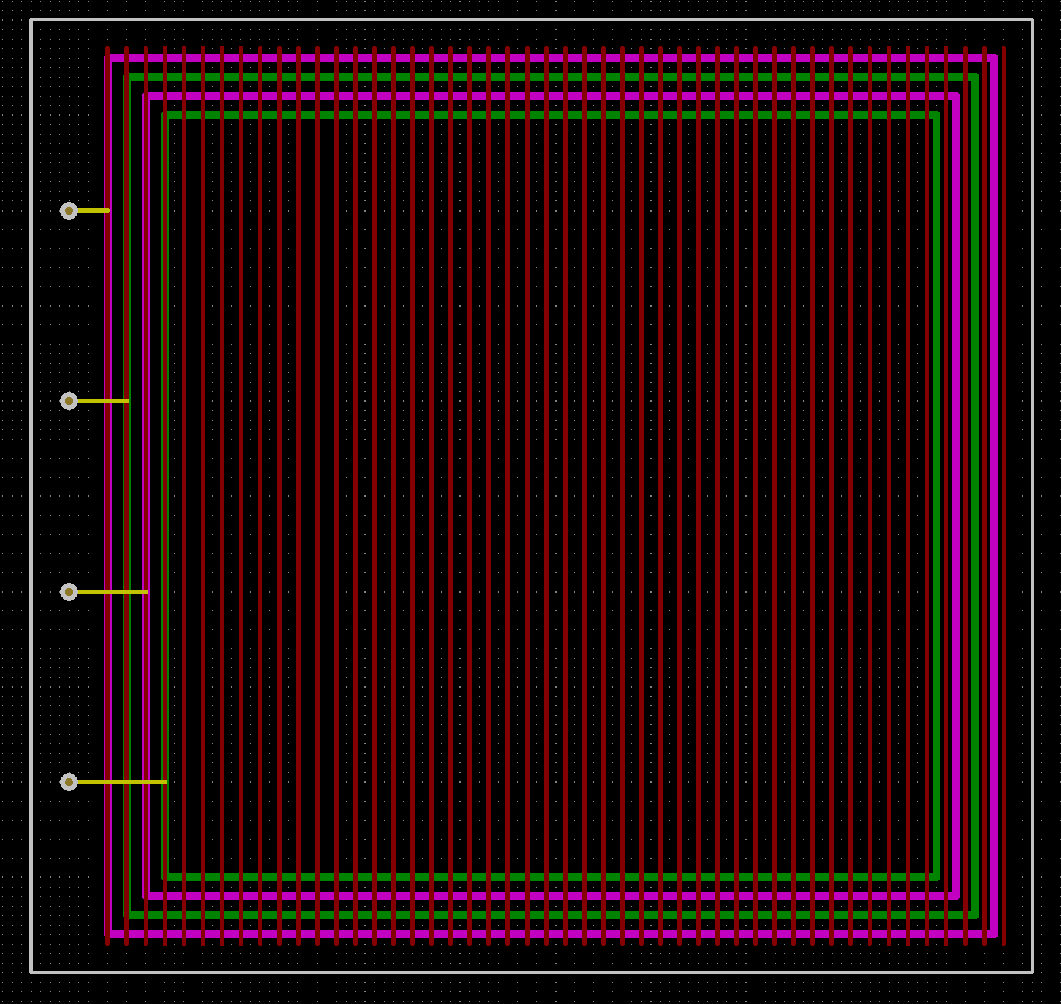
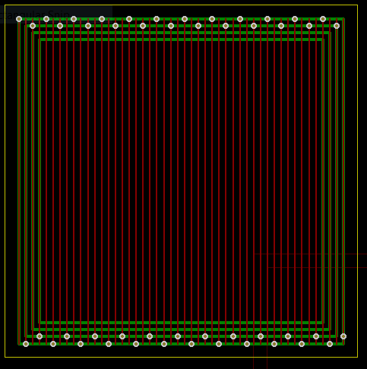
ELECTRICAL
EDS DESIGN
04/09/21
Amrita Mayavaram, Hope Arnett, Jules Pénot
Test Board 1
Test Board 2

